Slide 1
Reconfigurable Computing
Jason Li
Jeremy Fowers

Slide 2
Speedups and Energy Reductions From Mapping DSP Applications on an Embedded Reconfigurable System
Michalis D. Galanis, Gregory Dimitroulakos, Costas Goutis
University of Patras
Galanis, M.D.; Dimitroulakos, G.; Goutis, C.E.; , "Speedups and Energy Reductions From Mapping DSP Applications on an Embedded Reconfigurable System," Very Large Scale Integration (VLSI) Systems, IEEE Transactions on , vol.15, no.12, pp.1362-1366, Dec. 2007

Slide 3
FPGA-Based Embedded Motion Estimation Sensor
Zhaoyi Wei, Dah-Jye Lee, Brent Nelson, James Archibald, Barrett Edwards
Brigham Young University
Zhaoyi Wei, Dah-Jye Lee, Brent E. Nelson, James K. Archibald, and Barrett B. Edwards, “FPGA-Based Embedded Motion Estimation Sensor,” International Journal of Reconfigurable Computing, vol. 2008, Article ID 636145, 8 pages, 2008. doi:10.1155/2008/636145

Slide 4
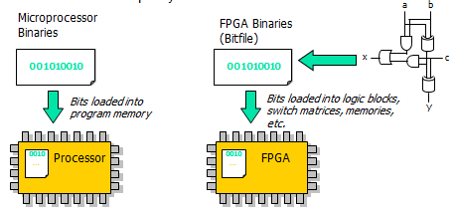
What is Reconfigurable Computing?
Architecture that adapts to specific application
Processing unit coupled with reconfigurable hardware
After execution, reconfigures hardware for next task
Implementing circuits without fabricating device

Slide 5
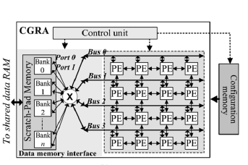
Introduction
Reconfigurable Hardware combined with µP
µP => noncritical control intensive
Hardware => kernels
Coarse-grained reconfigurable arrays (CGRA)
Array of processing elements (PEs)
Word-level parallelism

Slide 6
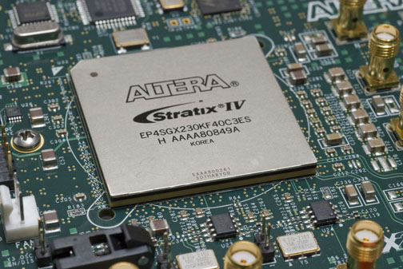
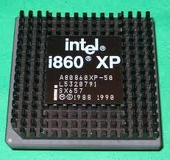
Introduction
Seven DSP benchmarks
Three 32-bit ARM processors
Two CGRA architectures
Application Speedup
Energy Consumption vs µP/VLIW system

Slide 7
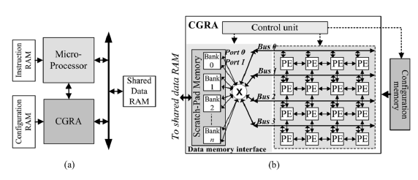
Architecture Overview
Shared data RAM used for communication
µP with instruction memory for storing program code
CGRA with memory for complete configuration
PE array with bus connecting rows and columns
Load data into PEs
Manages CGRA execution; set by µP

Slide 8
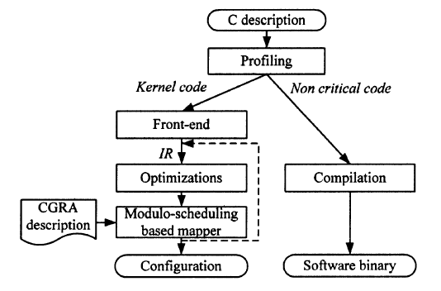
Design Flow Outline
Distinguish kernel from non critical
SUIF2 and MachineSUIF compiler
Loop Unrolling
Scheduler exploits ILP

Slide 9
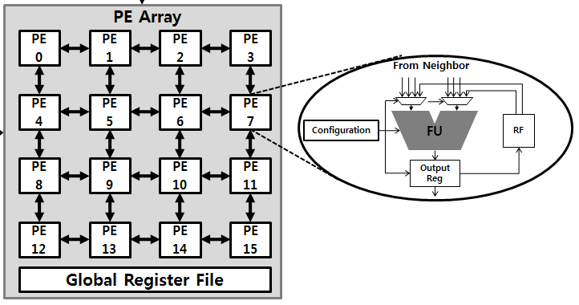
Experimental Setup
CGRA1 = 4x4 array, CGRA2 = 6x6
150 MHz
CGRA1 power consumption is 154.5 mW
CGRA2 power consumption is 258 mW
ARM7
ARM9
ARM10
133 MHz, 26.6 mW
250 MHz, 112.5 mW
325 MHz, 195 mW

Slide 10
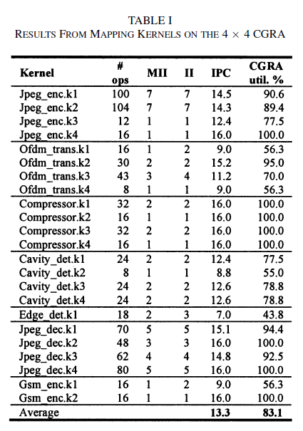
Experimental Results - Mapping
When II = MII, performance is
optimal
Optimum performance in 19/23
Average CGRA utilization is
13.3 IPC or 83.1%
71.7% usage in CGRA2

Slide 11
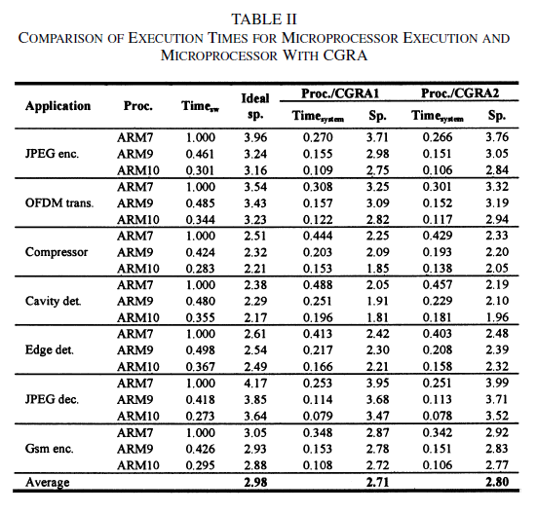
Experimental Results - Speedup

Slide 12
Experimental Results - Speedup
Speedups range from 1.81 to 3.99
ARM7 = 2.86, ARM9 = 2.74, ARM10 = 2.57
ARM7 has highest CPI
Speedups are all close to ideal
CGRA2 is only 6% less

Slide 13
Experimental Results - Energy
Energy Estimation
Time_{proc} = noncritical software
Time_{CGRA} = kernel execution time
P_{mem_icon} = shared data RAM and interconnection power consumption

Slide 14
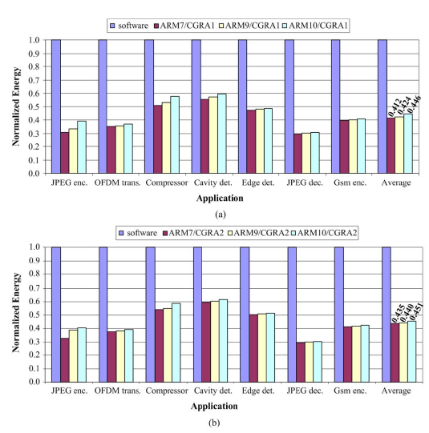
Experimental Results - Energy
ARM coupled
with 4x4 CGRA →
ARM coupled
with 6x6 CGRA →

Slide 15
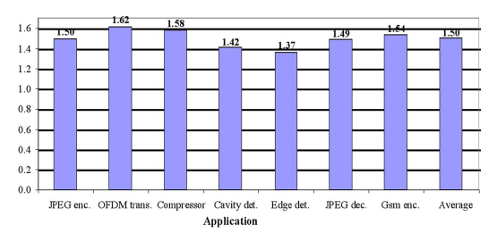
Experimental Results – vs. VLIW
CGRA1 is used due to greater energy savings
Compared to µP coupled with eight-issue VLIW

Slide 16
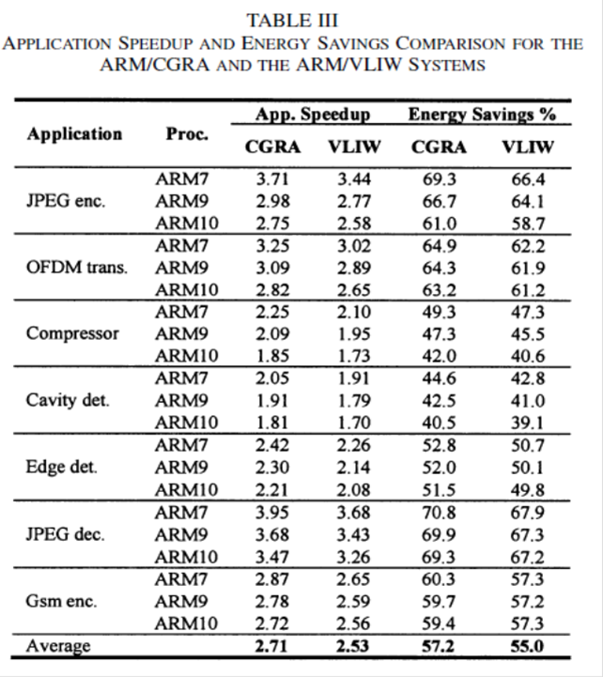
Experimental Results – vs. VLIW
Avg speedup
2.71 compared to 2.53
Avg Energy Savings
57.2% compared to 55%

Slide 17
Conclusion
Significant speedup and energy reductions
Compared to pure software implementation
Compared to VLIW system
Reconfigurable Computing Application
Optical Flow using FPGA

Slide 18
FPGA-Based Embedded Motion Estimation Sensor
Zhaoyi Wei, Dah-Jye Lee, Brent Nelson, James Archibald, Barrett Edwards
Brigham Young University
Zhaoyi Wei, Dah-Jye Lee, Brent E. Nelson, James K. Archibald, and Barrett B. Edwards, “FPGA-Based Embedded Motion Estimation Sensor,” International Journal of Reconfigurable Computing, vol. 2008, Article ID 636145, 8 pages, 2008. doi:10.1155/2008/636145

Slide 19
Optical Flow
Measure the motion of pixels between consecutive frames
Performed on images’ brightness pattern
Major implications for 3D vision, UAVs
Applications:
Navigation, moving object detection, motion estimation, structure from motion, time-to-impact

Slide 20
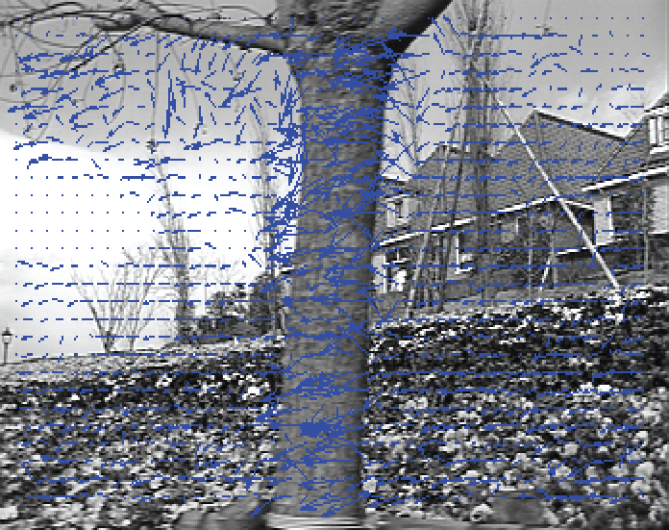
Optical Flow

Slide 21
Real-time Optical Flow
Notoriously difficult to execute in real time
CPU is too slow, parallelism necessary
GPU acceleration works, not embedded friendly
FPGAs ideal for embedded optical flow
Low power + fast parallel processing
Attempted in many previous works

Slide 22
Embedded Optical Flow
Previous embedded work made compromises
Algorithm limitations
Ideal algorithm: iterative steps
Ideal hardware: data parallel or pipelined
Resource limitations
Smoothing important, expensive

Slide 23
Algorithm (Math Alert)
The next slide has all of the equations
Use it to get an idea of the computational load
Refer to the paper to learn details

Slide 24
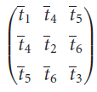
Algorithm
Averaged gradient $∇\overline{g}\left(x\right)$ = $\sum_{i}{w_{i}∇g(x_{i})}$
Mask: d = (1 -8 0 8 -1)
Outer product (3x3) O = $∇\overline{g}\left(x\right)$ $∇\overline{g}\left(x\right)T$
Gradient Tensor (3x3) T = $\sum_{i}{c_{i}O_{i}}$

Slide 25
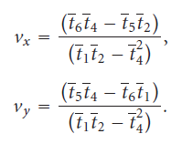
Algorithm Cont.
Optical Flow: pixels/frame = ${\left(v_{x}, v_{y}\right)}^{T}$
t_{i} are elements of T
Smooth Optical Flow $\overline{v_{i}}= \sum_{i}{m_{i}\left({v_{xi} \atop v_{yi}}\right)}$

Slide 26
End Math Zone

Slide 27
Smoothing Masks
Filter every stage to improve accuracy
c_{i} is 3x3 spatial, m_{i} is 7x7 spatial
w_{i} is 5x5x3 temporal (3 frames)
Accessing previous frames very expensive
First paper to do this in HW
Greatly improves accuracy

Slide 28
Hardware Structure
Derivative Module
SRAM
Optical Flow Module
High Speed Bus (PLB)
Camera
SDRAM
Note: Reduced system diagram

Slide 29
Derivative Module
SDRAM
SRAM
Temporal Gradient
frame(t-1)
g_{t}(t)
Camera
frame(t)
frame(t-3)
frame(t-4)
frame(t-2)
Spatial Gradient
g_{x}(t)
g_{y}(t)

Slide 30
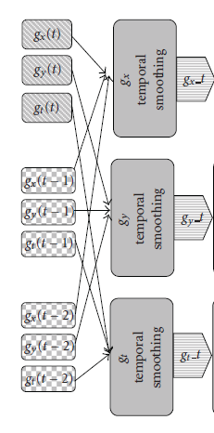
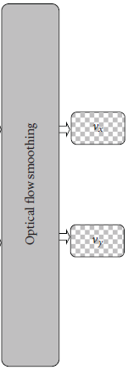
Optical Flow Module

Slide 31
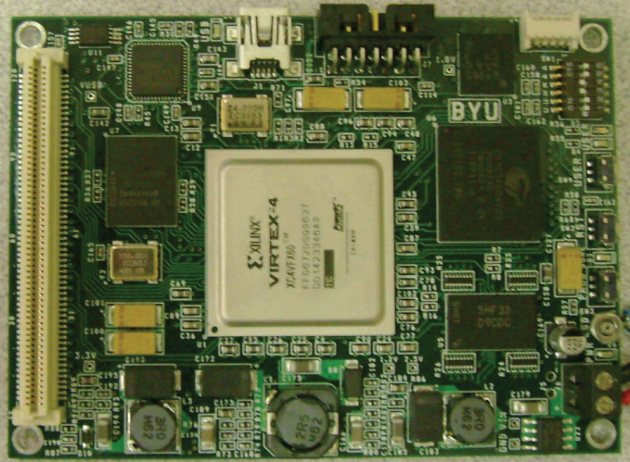
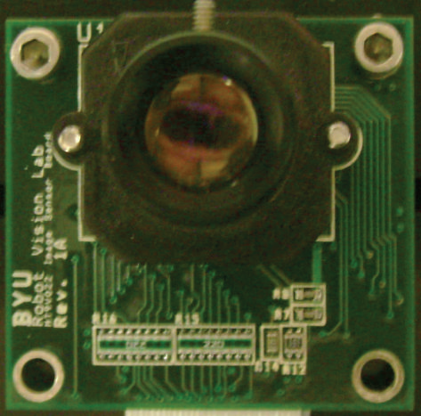
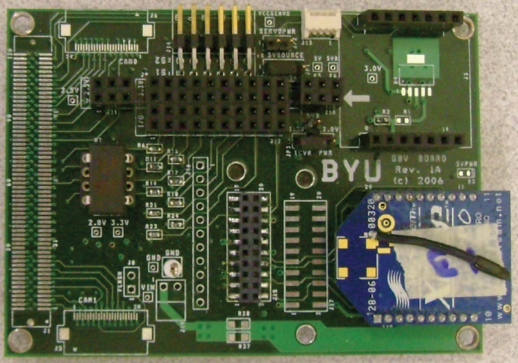
Hardware Platform
Virtex-4 FX60 FPGA, 100 MHz Clock
32Mb SDRAM, 4 Mb SRAM
2x built in 400 MHz PowerPC cores
CMOS Camera, 30 FPS 640x480

Slide 32
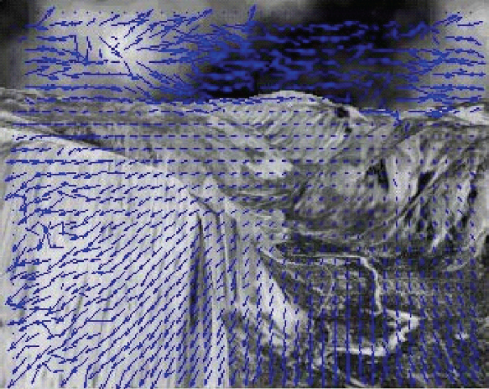
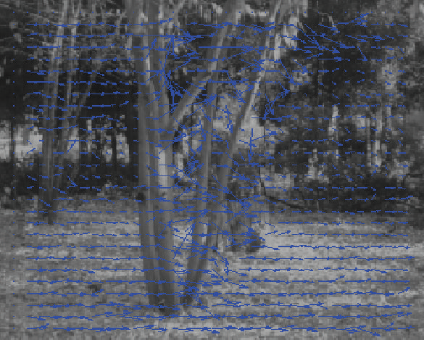
Testing
Camera data for frame rate
MATLAB simulation for accuracy

Slide 33
Results
Achieved 15 FPS
Suitable for some UAV apps
Accuracy 2x better than previous work
Authors: 6.7º
Previous: 12.7º
SW: 1.0º
Importance of temporal smoothing
10.6º without it

